Slide 1
Educating Future Nurses: How I survived, and they thrived in a pandemic.
Sinead Yarberry, DNP, APRN-CNP Meredith Hausmann, MA, RN, CCRP

Slide 2
Goals
Reflect on feelings related to challenges and opportunities for online teaching
Learn about UITL resources that were used to support the transition to online teaching
Gain ideas related to what may work online in your course
Believe that you can let go of “the way we have always done it”

Slide 3
Nursing 6271 Background
Students in the Course
Last course in the graduate entry pre-licensure nursing program
Enrollment 80-95 students each Autumn semester
Conduct of the Course
Taught in a stadium style lecture hall
Weekly lectures delivered live from 2pm-4:45pm
It had “always been done that way”
NCLEX-RN Pass rates were high and steady
Adding “Small Teaching” in AU19
Used 5-minute reflections at the end of class to engage in active learning
Application of class content, muddy points, etc.

Slide 4
The Before Semester Panic
Did not feel live Zoom lectures not best (for faculty or students)
Lectures were written but not pre-recorded
Carmen navigation needed updated for 100% distance learning
Exam proctoring?!?!
Grieving the loss of in person connection with students

Slide 5
Preparing for the Online Transition
Educating myself how to educate online
UITL modules provided a nice foundation
Knew the value of active learning
July 2020: 2 week “teaching online” course that offered many valuable lessons

Slide 6
Teaching Online Course – What I Took Away
Important of instructor presence
Clear communication regarding assignments & expectations
Intuitive Carmen navigation
Best practices for Zoom
Methods for active learning
Exam security without proctoring

Slide 7
How We Transformed N6271
Recorded a video introduction that was available before classes started
Being authentic about myself and virtual teaching/learning
Virtual office hours available
Recorded weekly module overview videos
Highlight learning objectives and how learning in the module would be evaluated
Utilized “keep teaching” assignment templates
Allowed for clear communication and uniformity
Weekly modules with “tabs”
Clear navigation
Pre-recorded lecture to cover content before class time with synchronous time reduced

Slide 8
CarmenCanvas Course Module

Slide 9
Transforming N6271
Cameras encouraged but not required. Purchased an external microphone and played with lighting/positioning
Worked through patient case scenarios with embedded NCLEX questions or Kahoot!
Zoom polling was used, plan to use Nearpod moving forward
Alternative assignment available if students were not able to log in to synchronous class

Slide 10
Transforming N6271 continued…
Used Exam Soft due to superior analytics, prior question bank available, and alternative question types available that match NCLEX-RN
Highlighted the importance of independent test taking, but acknowledged security limitations
Chose higher level questions, randomized questions and answers, timed exam with password
Reviewed and compared analytics to previous year
On the clinical side: Lippincott’s vSim available for virtual clinical hour make up

Slide 11
More Lessons Learned
Proud of the course I developed
Increased critical thinking seen in students
Improvement on objective exam averages
Changed attitude/perspective about content engagement
Plan to ask students to upload professional headshot to their Carmen Zoom account

Slide 12
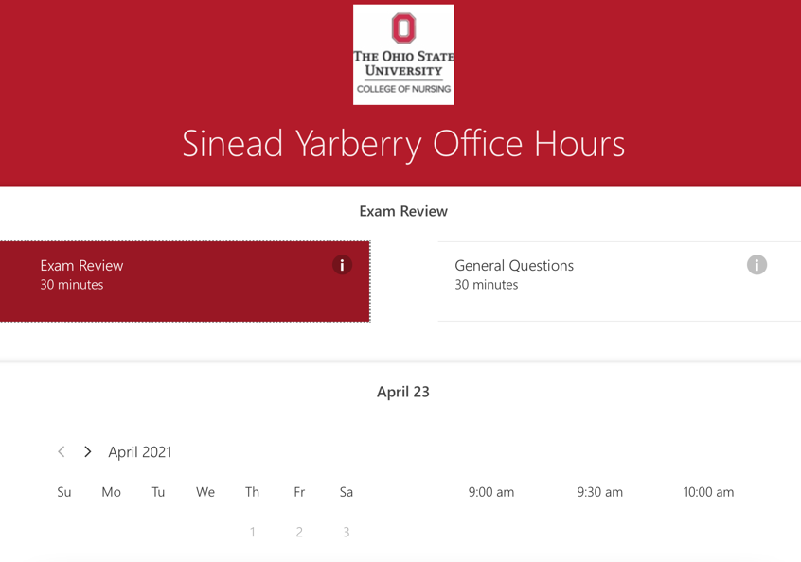
Autumn 2020 Lessons Learned
Nearpod next time to allow for easier duplication in future semesters and monitoring student engagement/progress
May try to do more with breakout rooms in the future
Microsoft Bookings for virtual office hours
Do not plan to go back to the “way we have always done it”

Slide 13
A Student’s Perspective
Carmen navigation was intuitive
Enjoyed listening to lecture first to identify areas for content clarification
Liked Case studies with Zoom polling and break out rooms for collaborative learning with telemetry strips
Kahoot! Was not just about knowing the answer but how quickly you could answer - enjoyed the “game/competitive” aspect

Slide 14
More Student Perspectives
VSim for make up clinical reduced stress related to missed hours and provided exposure to “rare” clinical situations
During cardiac arrest could pause the scenario
Advice for this year’s students:
Set up a schedule to stay on track!
Had purchased an NCLEX review book at the start of the semester
Be flexible

Slide 15
Remember…
Don’t hesitate to use university resources
Don’t hesitate to be transparent with students
You may find you really enjoy online teaching and students appreciate the flexible learning environment

Slide 16
Challenges and Agentive Responses in Teaching Online: Reflections and Lessons Learned
Grace J. Kim
PhD Candidate, Department of Teaching and Learning

Slide 17
Online Teaching Experiences

Slide 18
Emergency Online Teaching
Advanced Academic Writing in ESL (EDUTL 5902)
Spring 2020 (international students) In-person Asynchronous and individual meetings

Slide 19
Planned Online Teaching
Linguistic Diversity in Education (EDUTL 4303)
Autumn 2020
Undergraduate-level
Asynchronous
Linguistics for Literacy Education
(EDUTL 5365)
Autumn 2020
Graduate-level
(adult learners)
Synchronous
Weekly sessions
4:30
Advanced Academic Writing in ESL (EDUTL 5902)
Spring 2021
Graduate-level
(international students)
Asynchronous 6:50 via Zoom

Slide 20
Challenges and Agentive Responses in Online Teaching

Slide 21
Online Teaching amid the Pandemic
Required
Only Option
New to Many

Slide 22
Key Guiding Questions
What are the core learning objectives?
What are non-negotiables and negotiables? What can be changed and in what ways?
How can those key elements be transferred?
What resources and tools are available? Are those accessible to my students?
How can I better support the students in my class?

Slide 23
Challenges
Transformed to opportunities

Slide 24
Course Design, Assignments, Class Interactions and Feedback
Interaction and Building Relationships:
Instructor-Student Interaction
Student-Student Interaction
Limited options available: Delivery of instruction, assessment, and feedback

Slide 25
Course Design, Assignments, Class Interactions and Feedback continued
Interaction and Building Relationships
Limited options available: Delivery of instruction, assessment, and feedback
Individualized and timely feedback
More office/student hours
Short video-recordings and PPTs
More formative assessments and check-ins
Small group work

Slide 26
Unpredictable Situation due to the Pandemic
High stress and uncertainty
Health and safety Issues
International students’ travels
Students with children and/or family members to take care of

Slide 27
Unpredictable Situation Due to the Pandemic
High stress and Uncertainty
Health and Safety Issues
International students’ travels
Students with children and/or family members to take care of
Social and Emotional Learning
Trauma-informed Teaching
Individual Meetings
Individual Accommodations, Adjustments and Options

Slide 28
Technology
Optional tool → Necessity to continue teaching and learning
Numerous options to choose from
Learning curve for both instructor and the students
Accessibility issues
Technological support

Slide 29
Technology continued
Optional tool → Necessity to continue teaching and learning
Numerous options to choose from
Learning curve for both instructor and the students
Accessibility issues
Technological support
More tools ≠ Better Learning
Invitation to learn together
Consistency
On-campus resources and other tools

Slide 30
Lessons Learned, Remaining Questions and Future Directions
What have we learned? Where do we go from here?

Slide 31
Lessons Learned
Re-examine my positionality as an instructor & GTA
Revisit my teaching philosophy and practices
Challenged my own understanding of inclusive and equitable learning environment

Slide 32
Remaining Question and Future Directions
What can be transferred to planned distance learning, hybrid, and/or in-person courses?
How can those key “takeaways” be used to enhance teaching and learning?

Slide 33
Remaining Question and Future Directions continued
Professional communities and spaces to share resources, brainstorm ideas, and provide support
Self-care tools and social-emotional support for instructors

Slide 34
Thank you!
If you have any follow-up comments and/or questions, please email kim.6874@osu.edu.

