Slide 1
Facilitating Challenging Conversations in the Classroom
Innovate Conference
Shed Siliman (she/hers)
Instructional Consultant siliman.1@osu.edu
Jonathan Baker (he/his)
Associate Director baker.375@osu.edu

Slide 2

Issues that are on our minds

Slide 3

Why should we address these issues in class?
Notes:
9 minutes

Slide 4
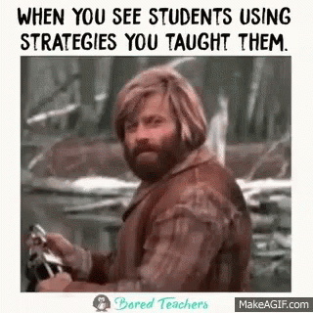
Why address in class?
To model behavior to students
  We’re not just teaching content!
To offer a protected space to explore challenging topics
  Offer tools for discussing these topics
To connect with students as people
Our students are whole people
Notes:
10 minutes

Slide 5

Pedagogical Framework

Slide 6
Intersectionality
Strategy to understand identity and oppression
Individual identity factors overlap (race, gender, class, orientation, (dis)ability)
Identity factors intersect to produce experience
Intersectional Approaches to Teaching about Privileges
(doi.org/10.5195/rt.2020.695)
Notes:
https://radicalteacher.library.pitt.edu/ojs/radicalteacher/article/view/695

Slide 7
Intersectionality Types
class
race
gender
status

Slide 8
Intersectionality Examples
UMC
mixed-race
female
U.S.
citizen
Notes:
23 minutes

Slide 9
Intersectionality in Teaching
Each of us is ‘whole people’
We bring our whole selves to the classroom
    Students deserve to be taught to their whole selves
There is privilege in separating politics from education
Education reflects politics, and vice versa
female
UMC
mixed-race

Slide 10
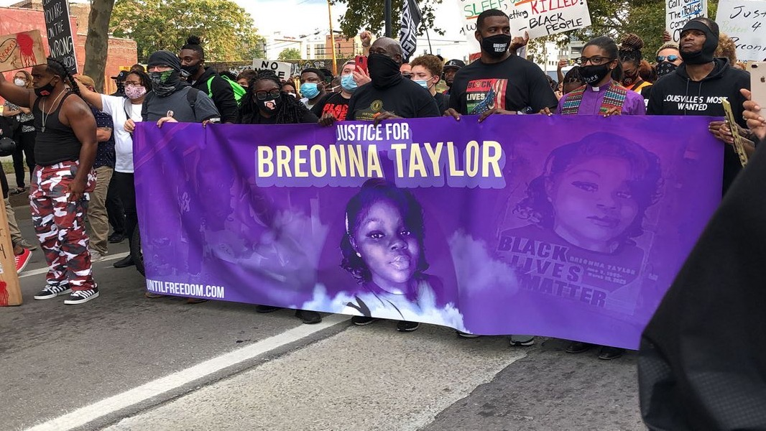
How Politics is Connected to Education
Notes:
20 minutes

Slide 11

Nationally, Black girls are suspended at six times the rate of white girls, while Black boys are suspended at three times the rate of white boys (Department of Education finding quoted in “Black Girls Matter,” 2014)

Slide 12
Our Concerns
Share in the chat:
What concerns do you have about addressing this topic in class?
Notes:
27 minutes

Slide 13
Addressing Our Concerns
You can address these issues
Emphasize curiosity, exploration, listening, reflection, dialogue, understanding, respect rather than agreement, expertise
  Disciplinary skills
  Understanding > resolution
  Occupy multiple perspectives on the same issue
  Conversation should be generative/productive
Focus on empathy

Slide 14
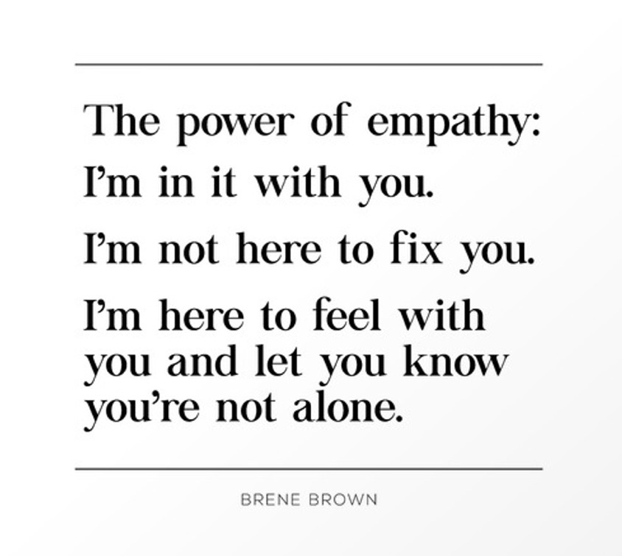
Cultivating Empathy
Notes:
28 minutes

Slide 15

Strategies for Engagement

Slide 16
Basic Guidelines
No matter the conversation:
Assess whether students and you are open to conversation
Be transparent about goals of the discussion
  Lower the stakes
Consider generating community guidelines
‘Call in’ instead of ‘call out’
Don’t talk ‘around’ the issue
Notes:
30 minutes

Slide 17
How I’ve Been Transformed
Dr. Baker
Relevant instruction
Keep it 1000
Adopting an anti-racist pedagogy
Being human and transparent

Slide 18
Spectrum of Engagement
Distant from class content
Somewhat related to class content
Directly related to class content

Slide 19
Spectrum of Engagement 2
Distant from class content
Acknowledge the issue, range of emotions
Actively facilitate; help students clarify comments
Share resources to help process and educate
Requires a list of resources, related texts/materials
Notes:
32 minutes

Slide 20
Spectrum of Engagement 3
Somewhat related to class content
Hold a conversation with students
Invite students to entertain different perspectives
Invite understanding > resolution
Validation > agreement
Requires conversation prep, variety of materials as sources
Notes:
34 minutes

Slide 21
Spectrum of Engagement 4
Directly connected to class content
Fully integrate topic into class content
Examined through disciplinary frameworks and methods
Prepare a more thorough activity and/or discussion
Requires planning to accommodate the topic in syllabus, decision on how it will connect to the course
Notes:
36 minutes

Slide 22
Potential Activities
Anonymous:
Write and toss
Word cloud
Google doc
Post-it activities
Poll
Teach students how to support each other
Identifying, but doesn’t require commentary:
Placing selves on spectrum/quadrants
Arranging ideas or materials according to value
Jigsaw
Students distribute resources
Identifying with commentary:
Sit in a circle and discuss
Share opinions aloud
Submit a reflection
Express reactions creatively
‘Debate’
Research sources
Notes:
40 minutes

Slide 23
Remember…
You don’t need to be an expert!
Incentivize > require engagement
Honor lived experience
Don’t rely on trauma for learning
Consider who we’re conditioned to see as ‘objective’ or ‘reactive’
Notes:
42 minutes

Slide 24

Examples

Slide 25
Example 1
During a class discussion, one student repeatedly misgenders another student, referring to that student as “he” instead of “they” when responding to that student’s comment.
How can you respond?
Notes:
42 minutes

Slide 26
Example 2
Your class is mid-discussion when one student checks their phone and makes an announcement. The student updates the class on the verdict of a high-profile court case. The case pertains to the killing of a Black woman at the hands of the police. The police on trial are found not guilty of abuse of force. The rest of the class immediately expresses a range of reactions to this news.
How can you respond?
Notes:
42 minutes

Slide 27
Example 3
The topic of anti-APIDA violence has been coming up in class lately. An incident of anti-APIDA violence happens over the weekend in Columbus, and you plan to discuss it with students at the end of Monday’s class session. However, as you start class, you realize that at least half of the class is already talking about the incident. Some students are expressing frustration and outrage.
How can you respond?
Notes:
42 minutes

Slide 28
Reflection and Sharing
As an instructor…
What is my investment in this issue?
What do I want students to take away from engaging this issue?
What are my limits on how students can behave?
  The minimum I ask of them
  The maximum I will allow
Notes:
45 minutes

Slide 29

Wrap Up

Slide 30
Questions and Comments
What questions do we have about applying these strategies to our classes?
Notes:
45 minutes

Slide 31
Resources at OSU
The Kirwan Institute
Office of Diversity and Inclusion (ODI)
  Dr. Moore
  Racial Justice Resources
Multicultural Center (MCC)
Respectful Dialogue Toolkit
Wexner’s 21-Day Anti-Racism Challenge
Drake Institute’s Teaching for Racial Justice
Counseling and Consultation Services

Slide 32
Thank you!
Innovate Conference
Shed Siliman siliman.1@osu.edu
Jonathan Baker baker.375@osu
Drake Institute of Teaching and Learning drakeinstitute@osu.edu
Notes:
https://ucat.osu.edu/blog/aftermath-tragedy/

Slide 33
Dealing with the Aftermath of Tragedy in the Classroom
ucat.osu.edu/blog/aftermath-tragedy

