Slide 1

Building Community with Equity and Care
Maha Bali, PhD
@bali_maha
Center for Learning & Teaching, American University in Cairo,
Virtually Connecting & Equity Unbound
Parts of this slide deck are co-designed with my daughter H.Fouad

Slide 2
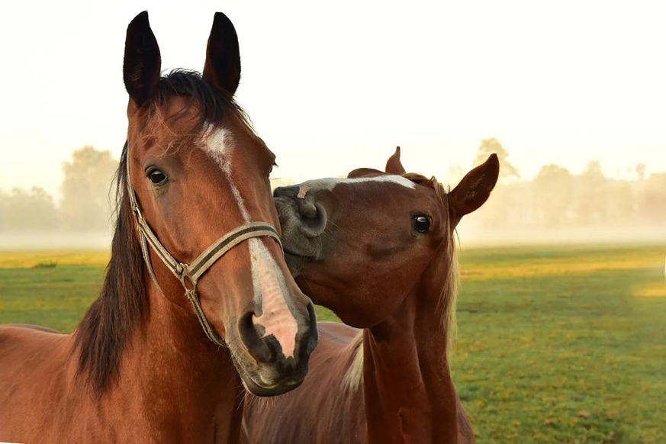
السلام عليكم
Ramadan Kareem
How are you feeling today?
Image from Pixabay https://pixabay.com/photos/horses-kiss-play-affection-3747374/

Slide 3
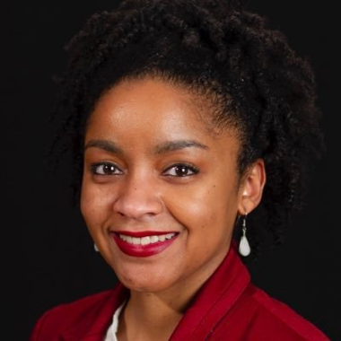
Territory Acknowledgement
We meet here on land that is indigenous territory. The following are the traditional stewards of the land in Ohio: Wyandot, Delaware, Shawnee, Ottawa, Miami, Eel River, Wea, Chippewa, Potawatomi, Kickapoo, Piankashaw, Kaskaskia, Mingo, Seneca and Ojibwa people.
From Jasmine Roberts (of OSU) keynote at OERxDomains21

Slide 4
Plan for this plenary
Checking in
Chatterfall
Equity & Care
  New: Roumy Cheese analogy
Practical tips for building community online with Intentionally Equitable Hospitality
Spiral Journal (key takeaways)

Slide 5


These slides are open for commenting
(bit.ly/OSUbali)

Slide 6
Keynotes appear like the work of one person, but they are inspired by many

Slide 7

Chatterfall
Please respond in the chat
Elijah Hiett on Unsplash

Slide 8

What gives you energy these days?
Image from Pixabay: https://pixabay.com/photos/sunset-beach-silhouettes-jump-570881/

Slide 9
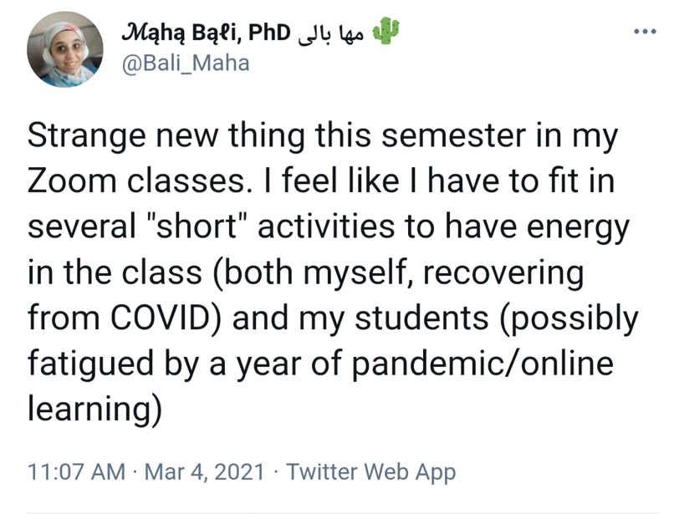
Tweet

Slide 10

What's an important thing you learned or achieved in the past year?
Image from Pixabay: https://pixabay.com/photos/sunset-rope-swing-girl-silhouette-5737120/

Slide 11

For me - to be useful to others, especially via community-building resources
(onehe.org/equity-unbound)
Image from Pixabay: https://pixabay.com/photos/people-jumping-happiness-happy-fun-821624/

Slide 12

What is an unexpected thing that brought you peace or joy recently?
Image from Pixabay: https://pixabay.com/photos/hand-gift-bouquet-congratulation-1549399/

Slide 13
Daily gratitude kept my 9 year-old positive during the time I had COVID.
I'm encouraging students to do regular gratitude journaling & it is helping them

Slide 14
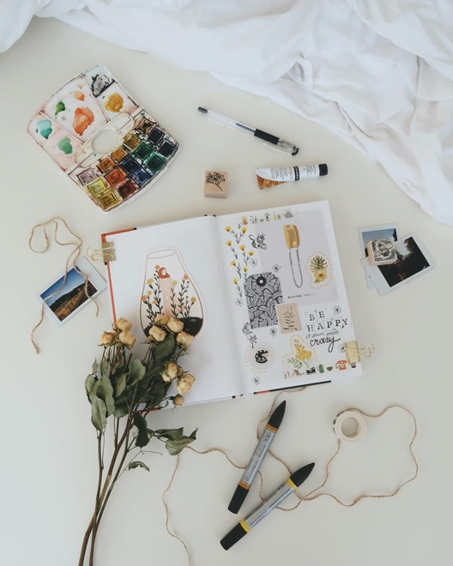
Resource on community building- gratitude journaling (onehe.org/eu-activity/ gratitude-journal)
Estée Janssens on Unsplash

Slide 15


Equity & Equality

Slide 16
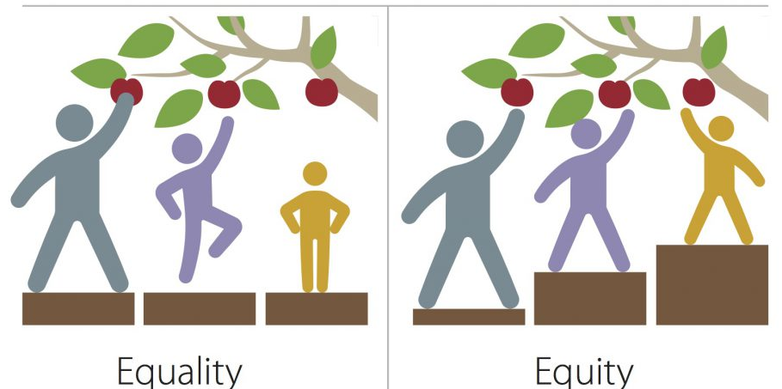
Equity vs Equality
“Equity vs Equality” flickr photo by MN Pollution Control Agency https://flickr.com/photos/mpcaphotos/31655988501 shared under a Creative Commons (BY-NC) license

Slide 17
Not everyone wants an apple...
Edited “Equity vs Equality” flickr photo by MN Pollution Control Agency https://flickr.com/photos/mpcaphotos/31655988501 shared under a Creative Commons (BY-NC) license

Slide 18

Maybe someone needs care
“an apple won’t satisfy their appetite for love” (my kid)
Edited “Equity vs Equality” flickr photo by MN Pollution Control Agency https://flickr.com/photos/mpcaphotos/31655988501 shared under a Creative Commons (BY-NC) license

Slide 19
“Marginality can be visible and invisible. Class background. Sexuality. Chronic or temporary disability when you're communicating online.”
Maha Bali, Foreword for Voices of Practice: Narrative Scholarship from the Margins
(hybridpedagogy.org/foreword-voices-of-practice)

Slide 20
What additional images or edits to the image could we make to express nuances?

Slide 21
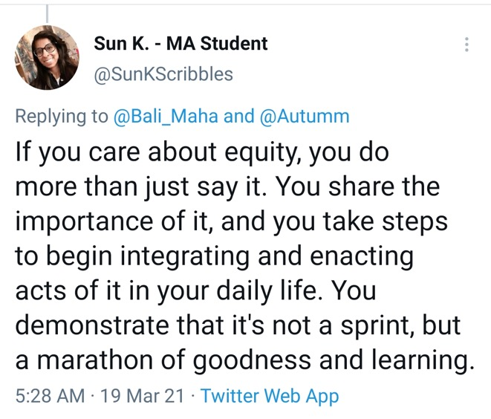
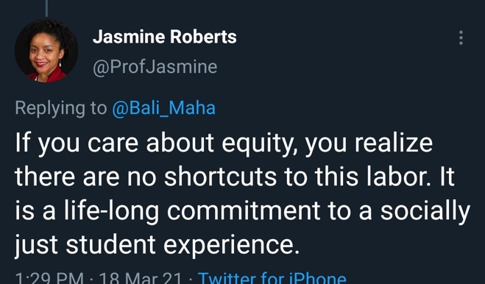
Realizing that image is static. We need to walk/run the talk - marathon not sprint. Lifelong commitment, no shortcuts

Slide 22
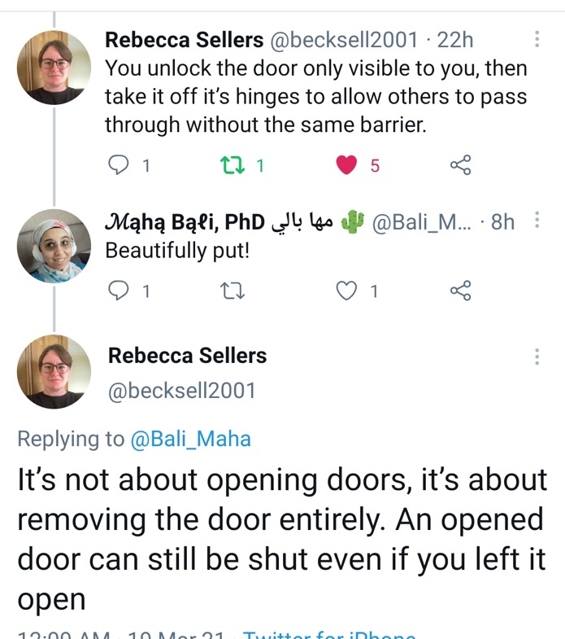
What about systemic inequality?
We need to completely remove doors, not just open them

Slide 23
Roumy Cheese analogy (thinking process on my blog)
(blog.mahabali.me/educational-technology-2/swiss-cheese-analogy-for-covid-19-rumi-cheese-analogy-for-inclusive-education)

Slide 24
Original by Ian McKay is about how no “one” mode of preventing spread of infection can protect you against the COVID-19 virus, but multiple together can help “fill the holes” more effectively

Slide 25

Social Justice and Care

Slide 26
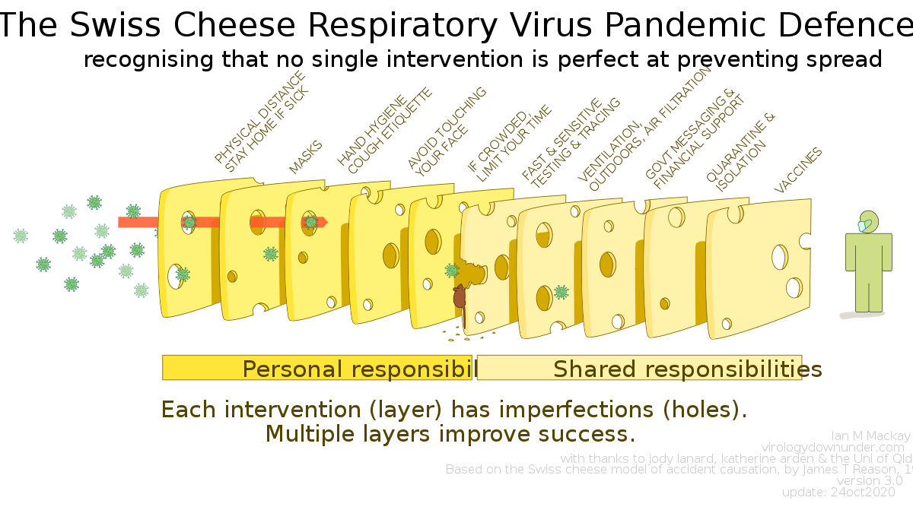
Original by Ian McKay from Wikimedia Commons CC-BY 4.0 (commons.wikimedia.org/wiki/File:Swiss_cheese_ver3.0.svg)

Slide 27
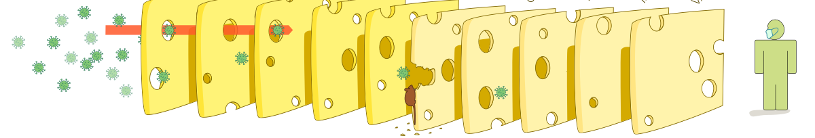








Roumy Cheese Analogy for Caring, Equitable Education
Maha Bali CC-BY-SA Adapted from Ian McKay’s virus analogy
Diverse Causes of Inequity, Need for Care:
Can you give examples?

Slide 28
What are some practices/strategies that can enable us to better create equitable and caring learning spaces?
Roumy Cheese Analogy for Caring, Equitable Education
Maha Bali CC-BY-SA
Adapted from
Ian McKay’s virus analogy
Culturally Relevant Pedagogy
Black peppercorn represent how some actions meant to promote justice for one group can be harmful for another group
Diverse Causes of Inequity, Need for Care:
E.g. Racism, classism, heteropatriarchy, ableism, neuronormativity, xenophobia, etc. Can be large (systemic) or small (individual) & intersectional

Slide 29
Roumy Cheese Analogy for Caring, Equitable Education
Maha Bali CC-BY-SA
Adapted from
Ian McKay’s virus analogy
Culturally Relevant Pedagogy
Universal Design for Learning
Institutional Policies (P/F, proctoring)
Self-mapped Learning Pathways
Intentionally Equitable Hospitality
Learner Agency
Trauma-informed Pedagogy
Building community in class
Other practices?
Black peppercorn represent how some actions meant to promote justice for one group can be harmful for another group
Diverse Causes of Inequity, Need for Care:
E.g. Racism, classism, heteropatriarchy, ableism, neuronormativity, xenophobia, etc. Can be large (systemic) or small (individual) & intersectional

Slide 30
Care with Parity of Participation
"In the caring approach, we would prefer to advise: do unto others as they would have done unto them." (Noddings)
I say: “Do unto students as THEY would have done unto THEM)
Noddings, N. (2012). The language of care ethics. Knowledge Quest, 40(5), 52.
Bali, M. (2020). https://www.timeshighereducation.com/campus/do-unto-students-they-would-have-done-them

Slide 31

Care with Parity of Participation
“Equal partners” with equal power to influence decision-making
Fraser, N. 2005. Reframing justice in a globalizing world. New Left Review, 36, Nov/Dec. Available from: newleftreview-org

Slide 32
Intentionally Equitable Hospitality
(elearnmag.acm.org/featured.cfm?aid=3331173)
Bali, Caines, Hogue, DeWaard & Friedrich, 2019

Slide 33
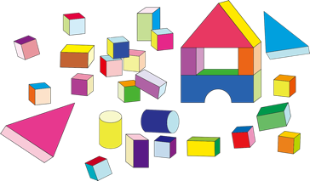
Intentionally Equitable Hospitality
You are a “host” building the space Hospitality is your responsibility - Whom do you involve/listen to? How do you make each person welcome?
Image by OpenClipart-Vectors from Pixabay

Slide 34

Intentionally Equitable Hospitality
Set your intention. Walk the talk. It won’t happen automatically or easily, so you need to set the intention - it is not enough to say “oh, I didn’t realize”

Slide 35


Intentionally Equitable Hospitality.
Recognize that if you intend to be hospitable to ALL students, you need to pay attention to the inequities faced by EACH student

Slide 36
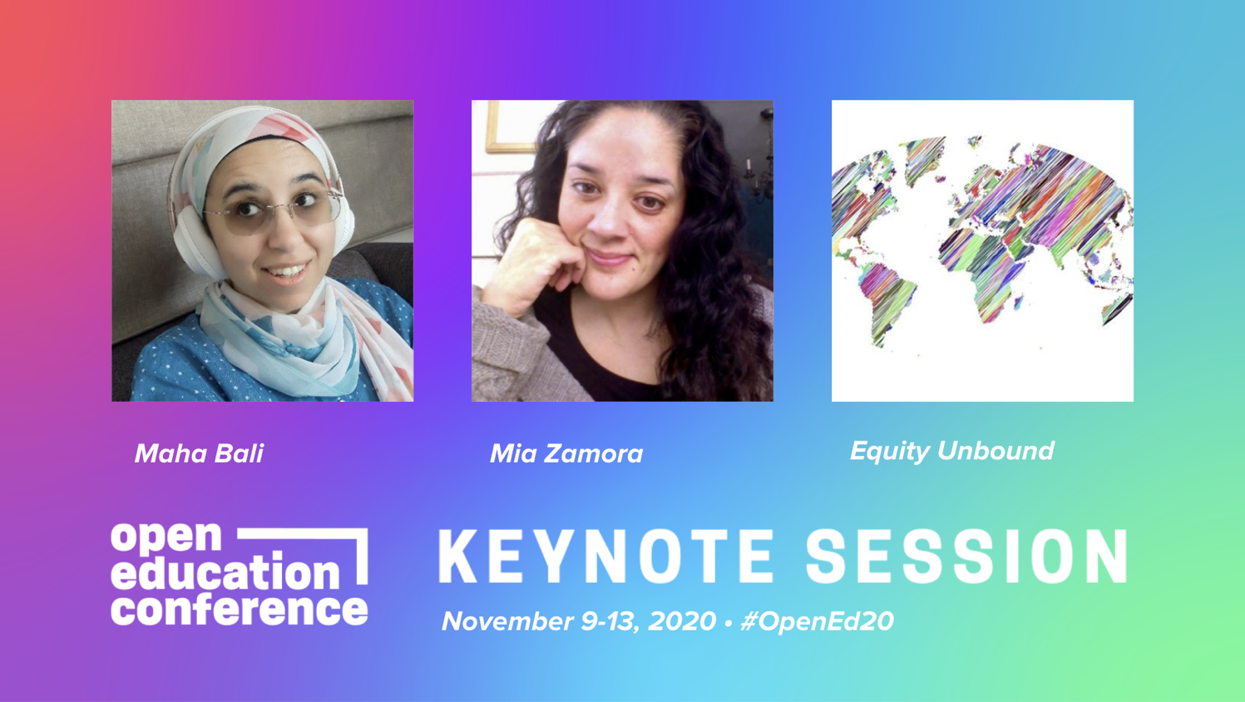
Equity/Care matrix
(youtu.be/NEeZvM6_8UE)
Bali & Zamora, 2020 and forthcoming

Slide 37


Levels of Care & Intentional Equity
How do you show it at each level?
Pedagogy of Care: Covid-19 Edition (blog.mahabali.me/educational-technology-2/pedagogy-of-care-covid-19-edition)
Personal/Private
Respond in Situations
Habitual practices in class
Course philosophy, design, planning
Notes:
Ideas from my blogpost: https://blog.mahabali.me/educational-technology-2/pedagogy-of-care-covid-19-edition/

Slide 38
Levels of Care & Intentional Equity: systemic
How do you embody it at each level?
Pedagogy of Care: Covid-19 Edition (blog.mahabali.me/educational-technology-2/pedagogy-of-care-covid-19-edition)
Personal/Private
Speak up in situations
Support others, form allyships
Advocate for caring, equitable policies institutionally
Notes:
Ideas from my blogpost: https://blog.mahabali.me/educational-technology-2/pedagogy-of-care-covid-19-edition/

Slide 39
“Teachers who care, who serve their students, are usually at odds with the environments wherein we teach”
Bell Hooks, 2003,
Teaching in Community, p. 91

Slide 40
Tronto advises us to resist neoliberalism which perpetuates inequality and lack of care:
“Humans can organize society so that they are not only and always in constant and vicious competition with one another”
Tronto (2013) p. 146

Slide 41
My version for universities:
“Universities can organize their systems so that faculty and students are not only and always in constant and vicious competition with their peers and one another”
Tronto (2013) p. 146

Slide 42
How might institutions promote equity/care? Reduce competition?
Equitable/fair treatment of those employed by the university, from recruitment, to pay, to promotion criteria - to job security
Equitable policies for students make it easier for teachers to care for students (e.g. cooperation between departments for students with disabilities)
Policies that reduce anxiety during the pandemic - such as P/NP policies, rejecting remote proctoring, etc.
Other ways?

Slide 43
What do we need to resist to promote equity/care? Reduce competition? Enhance students’ freedom?
Grading systems (arbitrary, competitive)
Remote proctoring - normalizing surveillance
Timed closed-book exams in general, especially standardized - normalizing authority
Arbitrary, strict deadlines that promote anxiety

Slide 44
What is EQUITY without CARE and what is CARE without EQUITY?

Slide 45




Justice? Parity Of Participation
Equity
TOKENISM?
DIVERSITY THEATER?
LIP SERVICE?
SYSTEMIC?
PERFORMANCE?
JUSTICE?
PARITY OF PARTICIPATION (Nancy Fraser)
Intentionally Equitable Hospitality?
No Care
Care
SELECTIVE & AFFECTIVE LABOR?
AMELIORATIVE?
BAND-AID?
SYSTEMIC INJUSTICE
Inequity
Notes:
Two Axes
Jail image: https://commons.wikimedia.org/wiki/File:Veave_in_jail.jpg

Slide 46
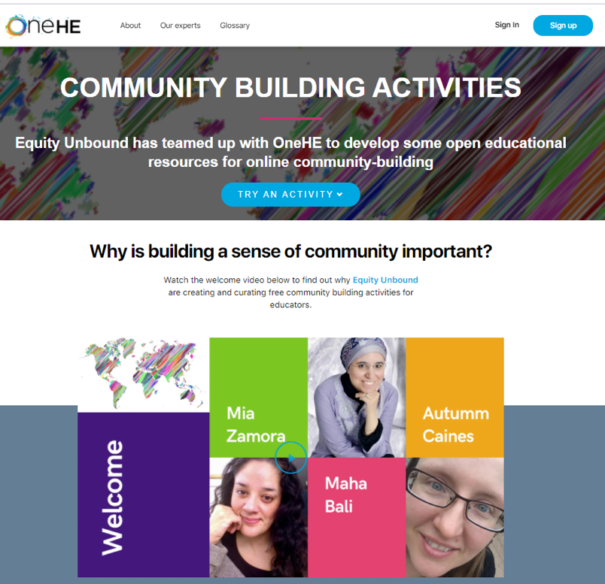
Dimensions of Community-building centered on care and equity
(onehe.org/equity-unbound)

Slide 47

WHY?
Many people were new to teaching fully online
Many of them did not know how to build community online
Inequitable access to faculty development support
Building community online is more important than ever due to trauma of pandemic
Many will be teaching synchronous, but there will be inequities
Care for teachers, so they can care for students

Slide 48
“the notion that one model of care will work for everyone is absurd...humans vary in their abilities to give and receive care”
(White & Tronto, 2004, p. 450).
Teachers and students vary in their abilities to give and receive care ONLINE! Context also matters!

Slide 49
Values Underpinning the Design
Intentionally Equitable Hospitality
Who has access? Whose culture dominates? Who has political power?
Adaptation by design AND adaptation in the moment. For care and equity

Slide 50

Some Dimensions
Introductions
Safety considerations
Warm-ups
Setting the tone
Ongoing community building and interaction

Slide 51
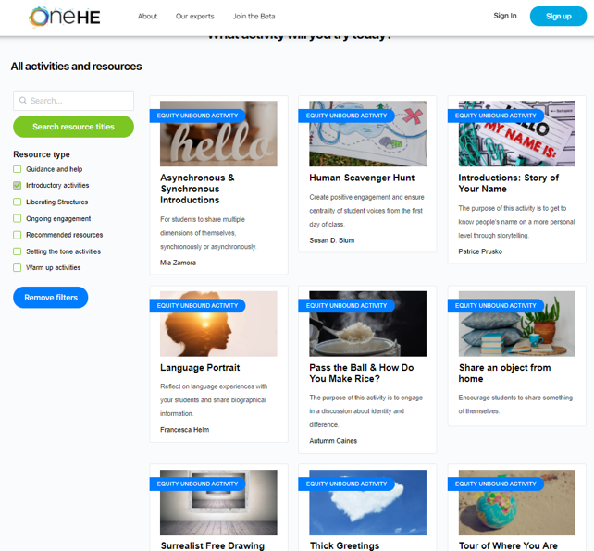
Introductions & Safety Considerations
Synchronous vs asynchronous approaches?
Story of your name - safety considerations
What kind of animal - cultural considerations
Tour of where you are - safety considerations
Surrealist drawing - deeper connotations

Slide 52
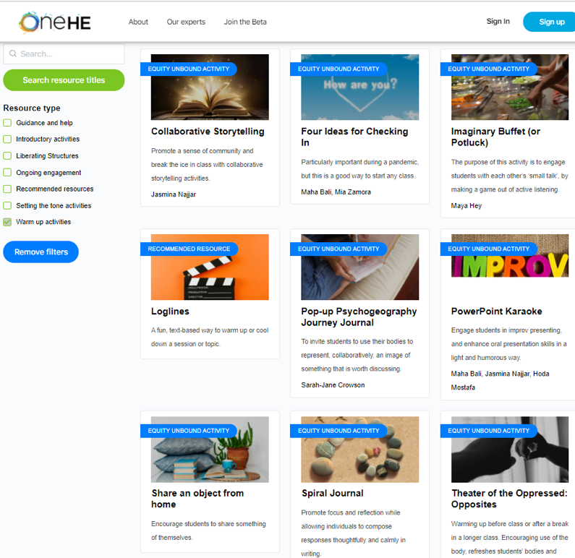
Warm-ups
Importance of checking in
Text-based, visual, oral
Writing on paper? Try Spiral Journal
Kinesthetic? Try Opposites
Energizing: Improv, PPT Karaoke
Whom might you exclude with some of these choices?

Slide 53
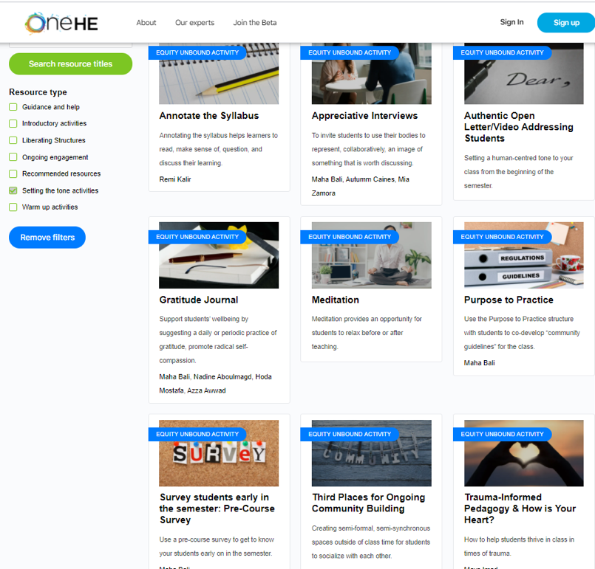
Setting the Tone
Annotating the syllabus
Trauma-informed pedagogy
Gratitude journaling
Third Places
Community guidelines (co-develop?)
Pre-survey, seeking feedback
Alternative grading

Slide 54
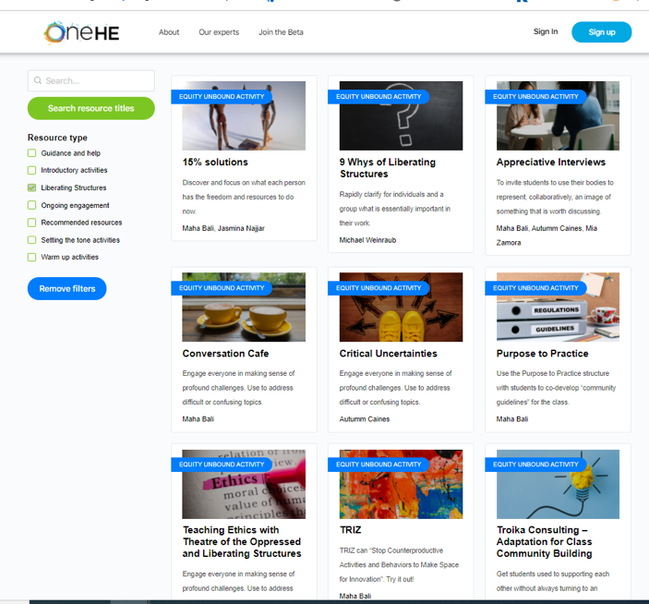
Ongoing Community Building & Liberating Structures
Ensuring everyone’s voice is heard: Try Conversation Cafe
Students learning from each other. Try: Troika Consulting
Ensuring students are engaged and engaging in different ways: Try TRIZ

Slide 55
Invitation to contribute!
(onehe.org/equity-unbound-form)

Slide 56
“When injustice and oppression are ongoing, hope may not be the appropriate response...To hope, we need to be discontent with the present and desire a better future; in fact, we need to be more than discontent -- we have to experience the agony and depth of the pain. Our pain can serve as a beacon, enabling us to move forward so we may begin to heal.” (emphasis added)
Mays Imad
(insidehighered.com/advice/2021/03/17/how-faculty-can-impart-hope-students-when-feeling-hope-depleted-themselves-opinion#.YJBws3NQUKM.link)

Slide 57
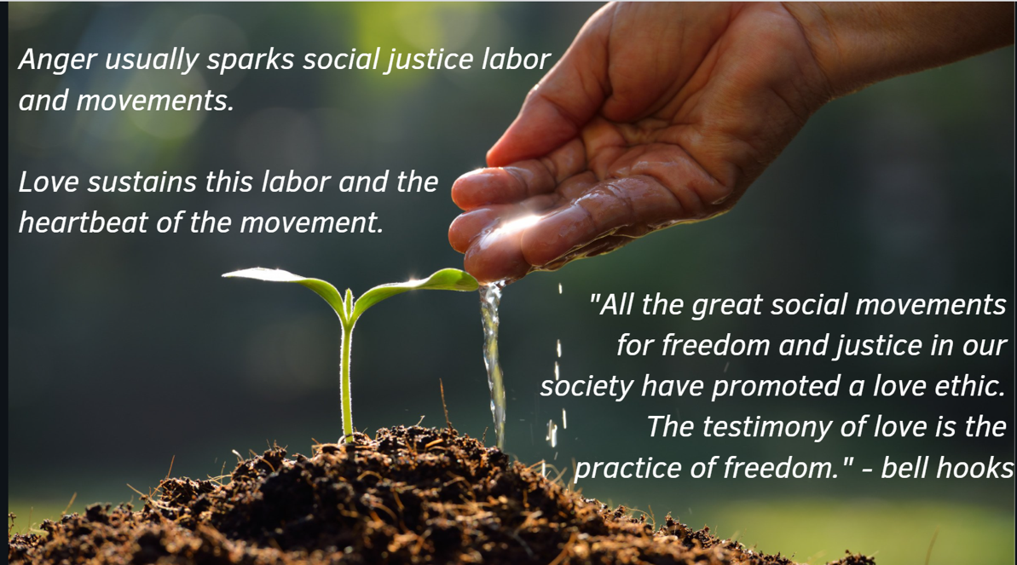

From Jasmine Roberts (of OSU) keynote at OERxDomains21

Slide 58
Debrief: Spiral Journal

Slide 59


Spiral Journal LS in development
(https://trello.com/b/9l6MUKTQ/ls-in-development)
Calmly prepare for the work ahead while sharpening observational precision.
Inspired by Lynda Barry
Slide theme co-developed with my daughter, H. Fouad
Notes:
Ask people to take pen and paper; explain what the Spiral Journal is about. 2 minutes

Slide 60

Draw a continuous spiral as slowly & tightly as possible

Slide 61
The most important thing I learned today is...
Notes:
Right now my body is feeling... The challenges I’m bringing with me into this workshop are... Something I’ve been paying close attention to is... Lately it’s been important for me to...

Slide 62
The most important thing I learned today is...
An action step I can take in the short term is...
Notes:
Right now my body is feeling... The challenges I’m bringing with me into this workshop are... Something I’ve been paying close attention to is... Lately it’s been important for me to...

Slide 63
The most important thing I learned today is...
An action step I can take in the short term is...
A challenge/question that remains for me is...

Slide 64
After this conference, I am hopeful about...
The most important thing I learned today is...
An action step I can take in the short term is...
A challenge/question that remains for me is...

Slide 65
Share one thought in the chat after doing this exercise

Slide 66




Thank You!
Slides (bit.ly/OSUbali)
Email: bali@aucegypt.edu
Twitter: @bali_maha
Feedback (bit.ly/balikeynotes)
Some graphics by my daughter, H. Fouad

